Slide 1
A Rumour of Angels
Dr Mike Scott, Consultant Psychologist and Author
michaeljscott1@virginmedia.com
Mother’s Union, Liverpool Anglican Cathedral
February 9th 2026

Slide 2
Isn’t It Weird That I Am Me, and You Are You?
It could be just random, but…….
Turn to the person next to you and tell them your name, or if you know them, tell them something about you that they don’t know
It got curiouser and curiouser during the pandemic, I would meet people in the park and find their story was totally different to what I imagined
In the laughter of an encounter you meet the other person – a rumour of angels. Laughter as the distinguishing feature of humans?

Slide 3
Laughing At Yourself
It tends to disappear if you become depressed or are traumatized
The rediscovery of humour helps you move on [ self-help book Moving On After Trauma (2024) 2nd Edition]
My grandson was born on the day of the London Bombing, July 7th 2005 and the inscription to ‘ Moving On….’ reads “No horror has the last word”.
This is not a proposition that you could prove by a scientific experiment
But a necessary belief to survive as Shakespeare says ‘the slings and arrows of outrageous fortune’
It is an echo of Good Friday doesn’t have the last word, with the Resurrection of Easter Sunday
Here again - ‘a rumour of angels’

Slide 4
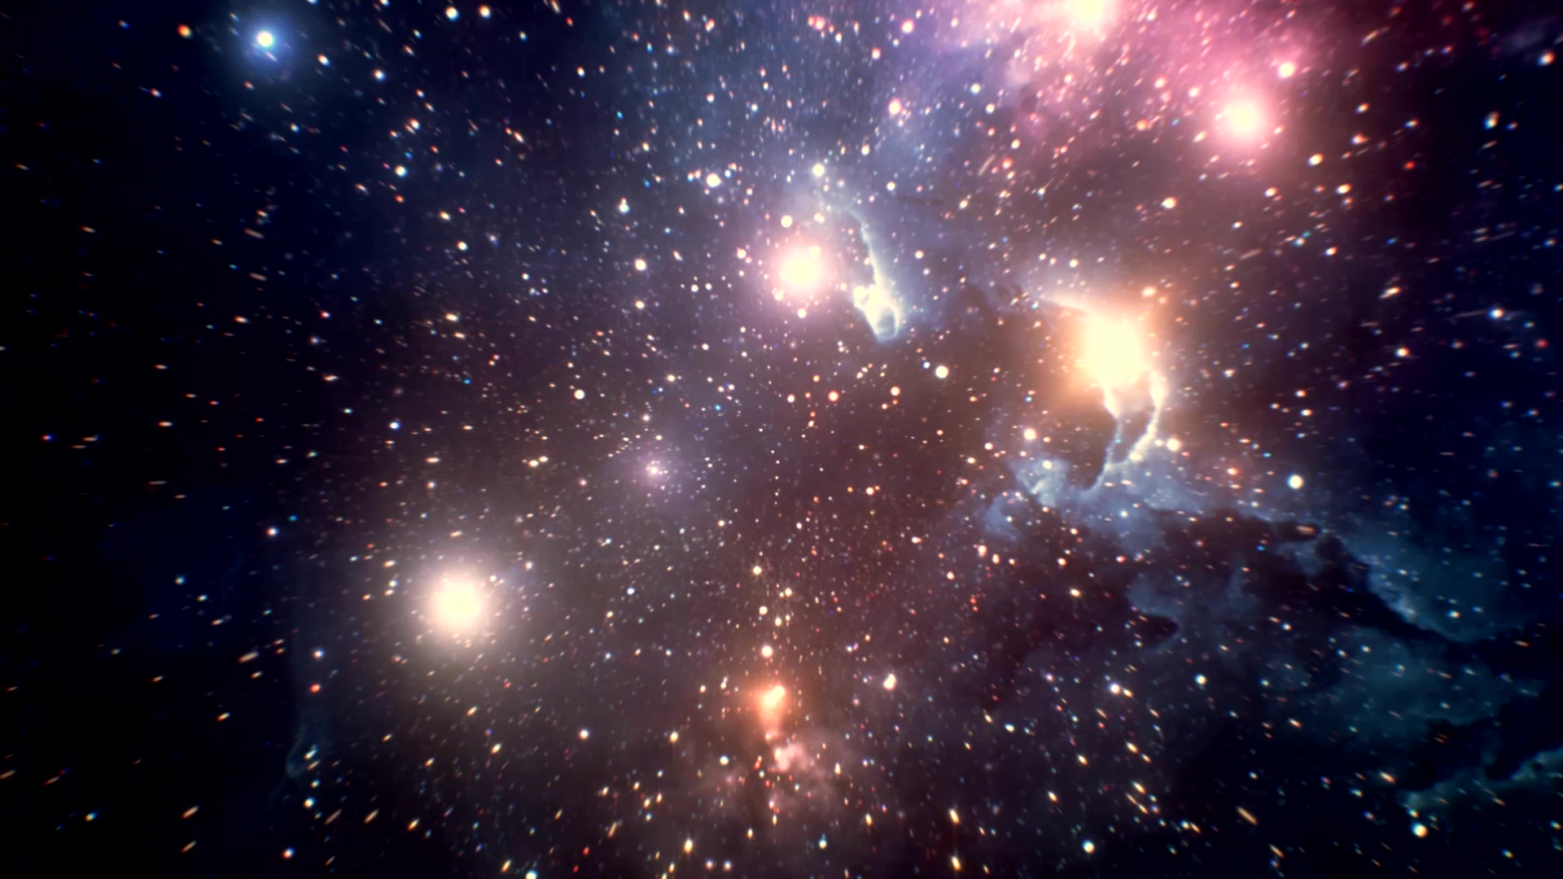
A Fine-Tuned Universe

Slide 5
2% Closer To The Sun and We Are Toast, 2% Further Away and We Are In The Deep Freeze
What is that about?
‘It is just the way it is’
You can explain the distance we are from the sun in terms of gravitational forces but that doesn’t explain why such forces operate
How come there are physical laws at all? Random nothingness would be on the cards. Laws without a law-maker?
There are constants in the physical universe such as the acceleration due to gravity, 32 ft per second per second, but if the values of these constants were even slightly different, there would be nothing at all
Ain’t that weird? – a rumour of angels

Slide 6
Age of Universe and Life
The Universe is expanding, like an inflating balloon, this makes it possible to trace its origins back to a point 13.8 billion years ago
But there was nothing before and it’s not possible to create something out of nothing!
The best explanation for this is…..
Life dates back over 5 billion years
But it is not possible to get life from non-organic matter (carbon free material)!
The best explanation for this is……….

Slide 7
What Do You The Jury Make Of All This?
In the Criminal Court juries return a guilty verdict only if the evidence presented is beyond reasonable doubt. This is deliberately set as a high bar to clear, to ensure the innocent don’t suffer. This is arguably Thomas’s response to claims of a resurrected Christ ‘unless I can put my hand into his side…..’
In the Civil Court, the domain of personal injury, judgements are given ‘on the balance of probability’. As an Expert Witness to the Court for over 25 years I spend a goodly portion of the week on civil litigation matters.
In looking at signs of transcendence would you declare that the Civil Court test is cleared or maybe even the Criminal Court bar. Alternatively, you might declare that ‘there is no case to answer’. If you declare the latter, a case can be made for a Public Inquiry into Weirdness!

Slide 8
The Case for ‘A Rumour of Angels’
Is not based on ‘faith’
It is simply the ‘best explanation’
Leaps of ‘faith’ are not confined to believers – I was visiting a Cathedral with an atheist friend who proclaimed to his young son ‘we believe in evolution’. I resisted scoring a point by saying ‘but does evolution believe in you?’. I don’t have a problem with evolution
Uncertainty is part of all human endeavours, including scientific experiments, there would be no need to conduct an experiment if there was no uncertainty. Managing uncertainty is a task for all. I would argue that it is not that believers are simplistic. Tolerating uncertainty is a challenge for all.

Slide 9
Bringing physics, social work and psychology together
For the past 50 years it has been the accepted wisdom that debility following extreme trauma arises because of ‘arrested information processing’ at the time of the trauma. Hence the need for trauma-focussed interventions involving repeated reliving.
My experience has been that this goes down like a ‘lead balloon’ with the traumatized.
I could understand what arrested information processing meant when my printer wouldn’t print out what was on my screen, but where oh where was the correlate in the human body
In my 2 most recent books I said that the theory doesn’t stack up and there is no need for repeated reliving

Slide 10
Centrality As A Better Explanation
I suggested it is the centrality accorded to the trauma for today that matters.
Recovery depends on not viewing yourself and your personal world through the lens of the trauma
Judas viewed himself through the events that led up through the crucifixion, a better perspective would have been looking thru the lens of the resurrection

Slide 11
Some books and materials of possible interest
‘Cosmic Chemistry’ by John C Lennox (2021) and You Tube debate with Lawrence Kraus
‘Morality’ by Jonathan Sacks (2020)
‘Moving on After Trauma 2nd Edition’ (2024) Michael J Scott
‘Personalising Trauma Treatment: Reframing and Reimagining’ (2022) Michael J Scott

